Slide 1
FRB Update #29
William Huang
(08/01/2021)

Slide 2
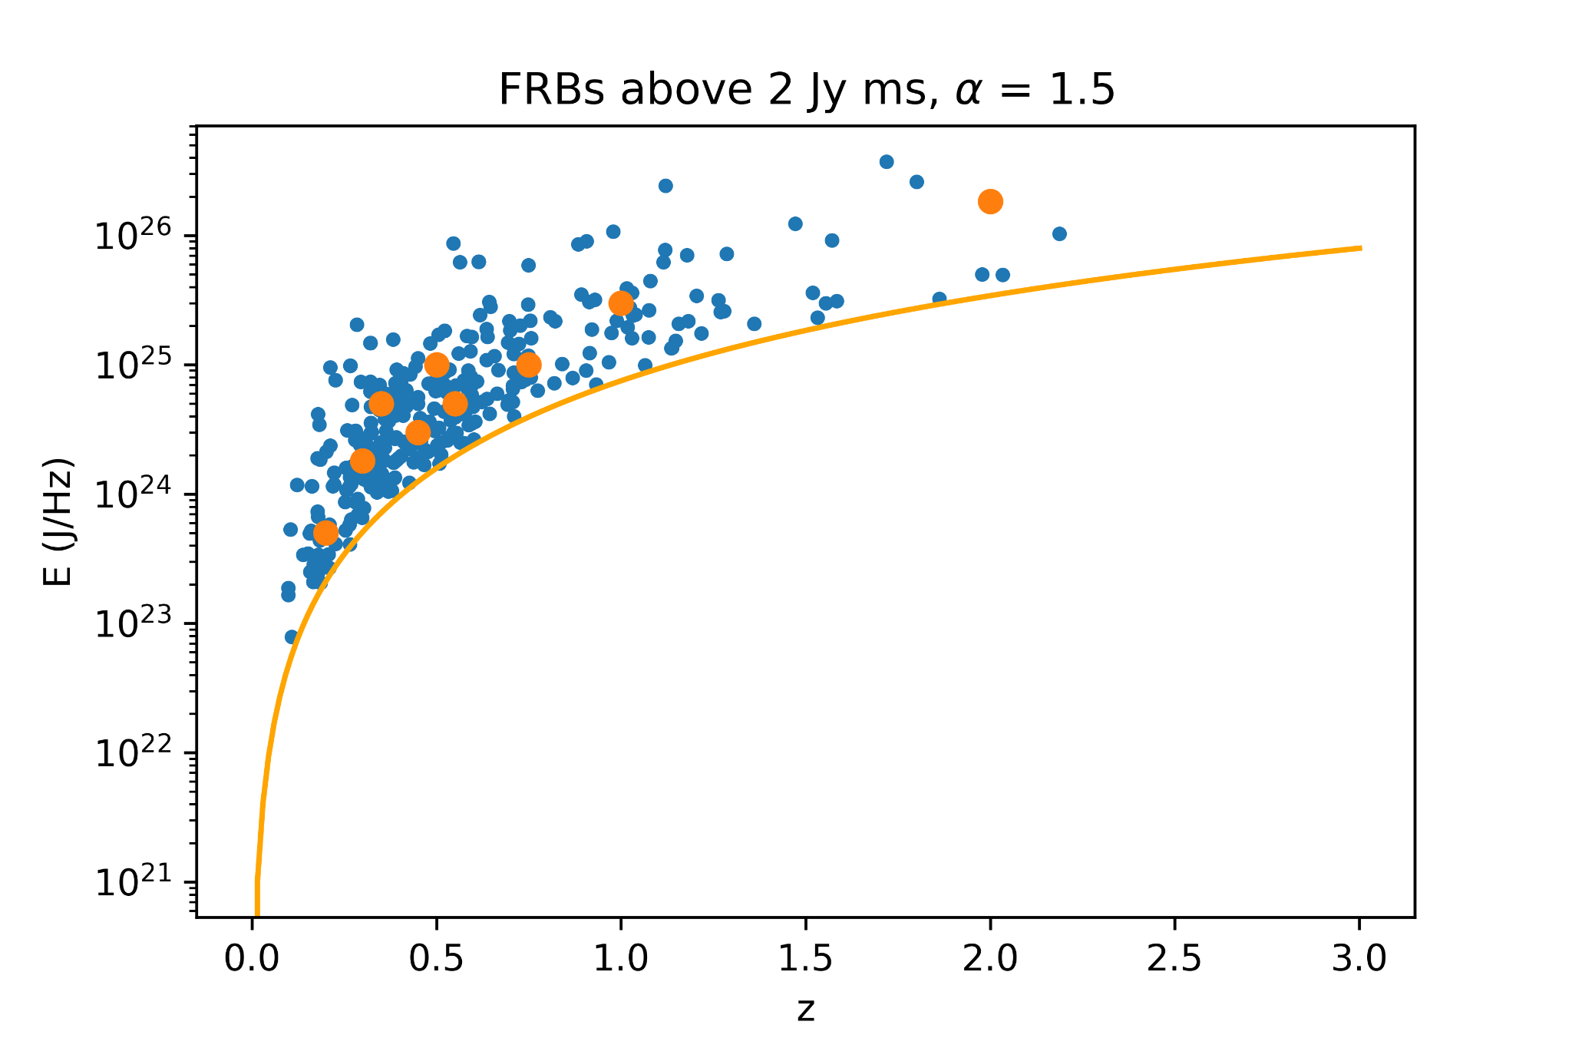
Debugging Kendall Tau
In order to debug kendall tau, I chose 9 points (in orange) to represent the ~300 FRB sample. I use alpha = 1.5 and a cutoff of 2 Jy ms.
For the ~300 FRB sample, a linear fit of log E vs. log(1+z) gives a slope of 5.77, while kendall tau provided a value of k~6.2.
Similarly, the 9 test points have a log E vs. log(1+z) slope of around 5.7, and kendall tau provides a value of k~6.5.

Slide 3

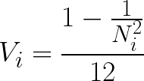


Current Formula for Kendall Tau
Currently, my formula for kendall tau is:
Rank is calculated as the number of points lower than the associated set plus one, divided by the total number of points in the associated set (N_{i}).

Slide 4
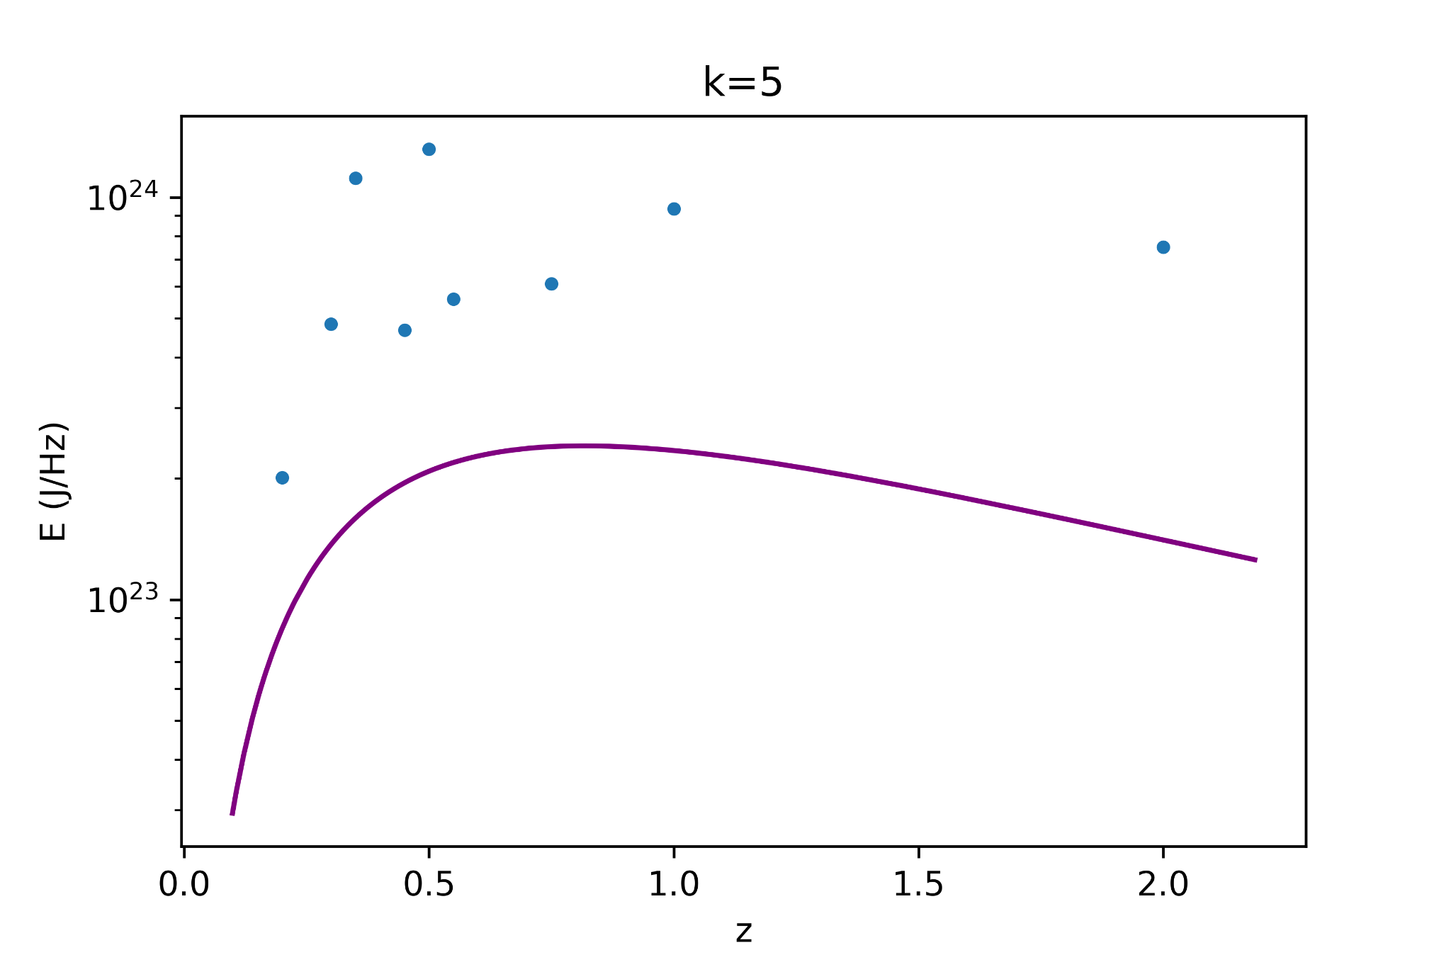
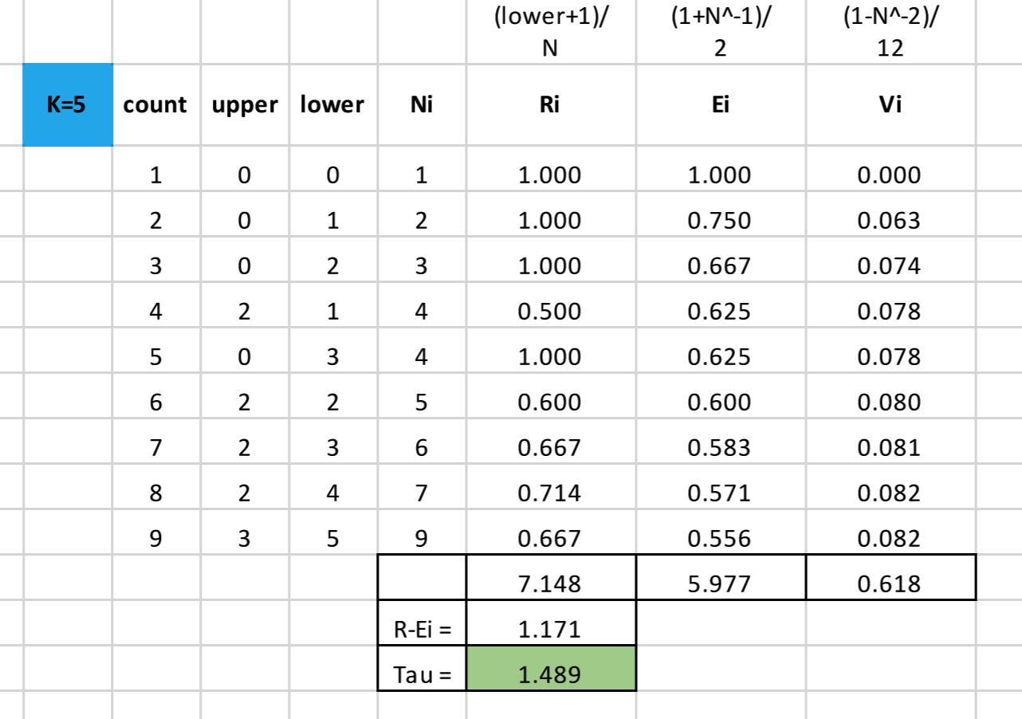
Example calculation: k=5
Here, I calculate kendall tau for k=5. The “count” column indicates the index from left to right.

Slide 5
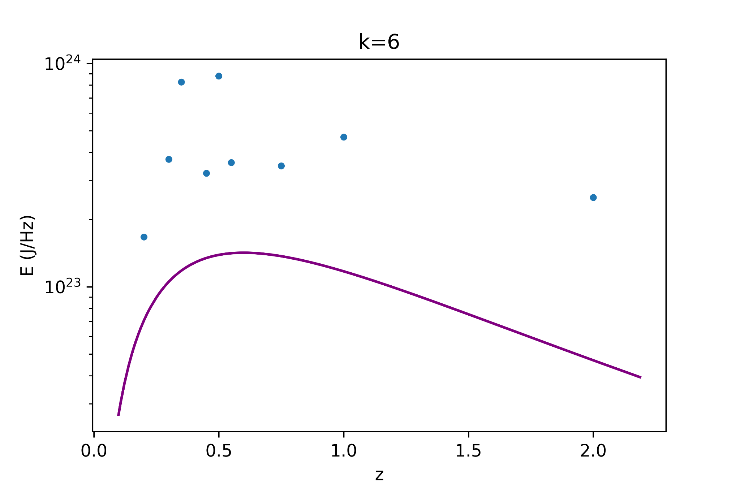
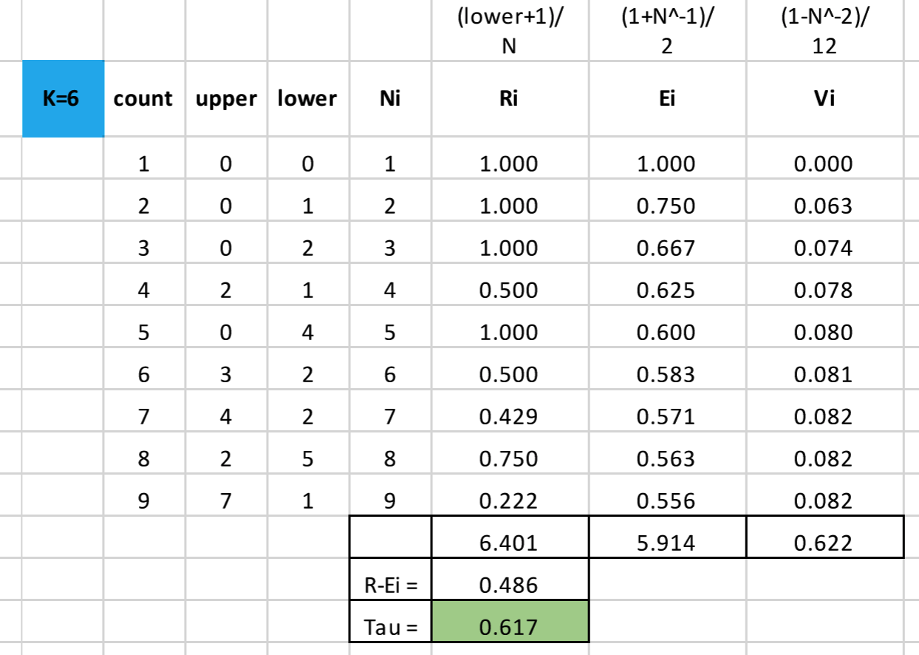
Example calculation: k=6
I calculate kendall tau for k=6.

Slide 6
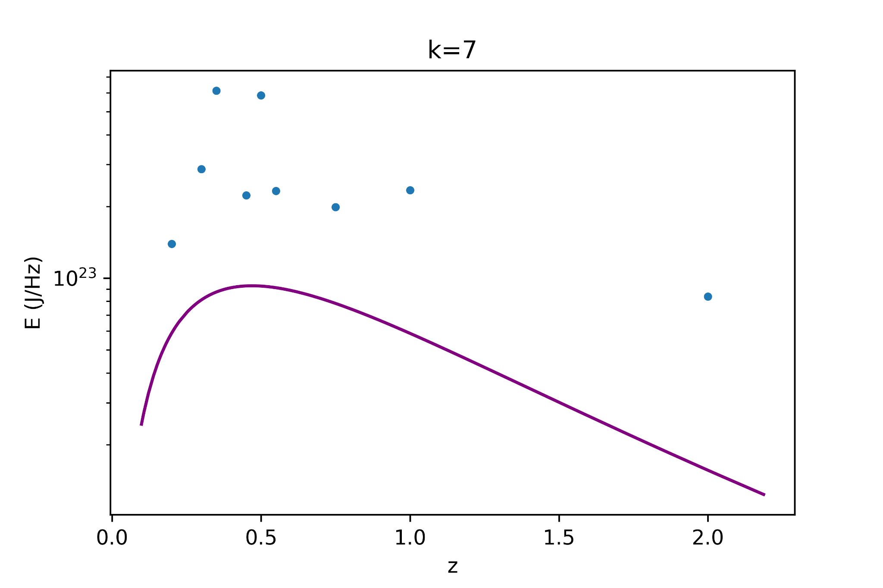
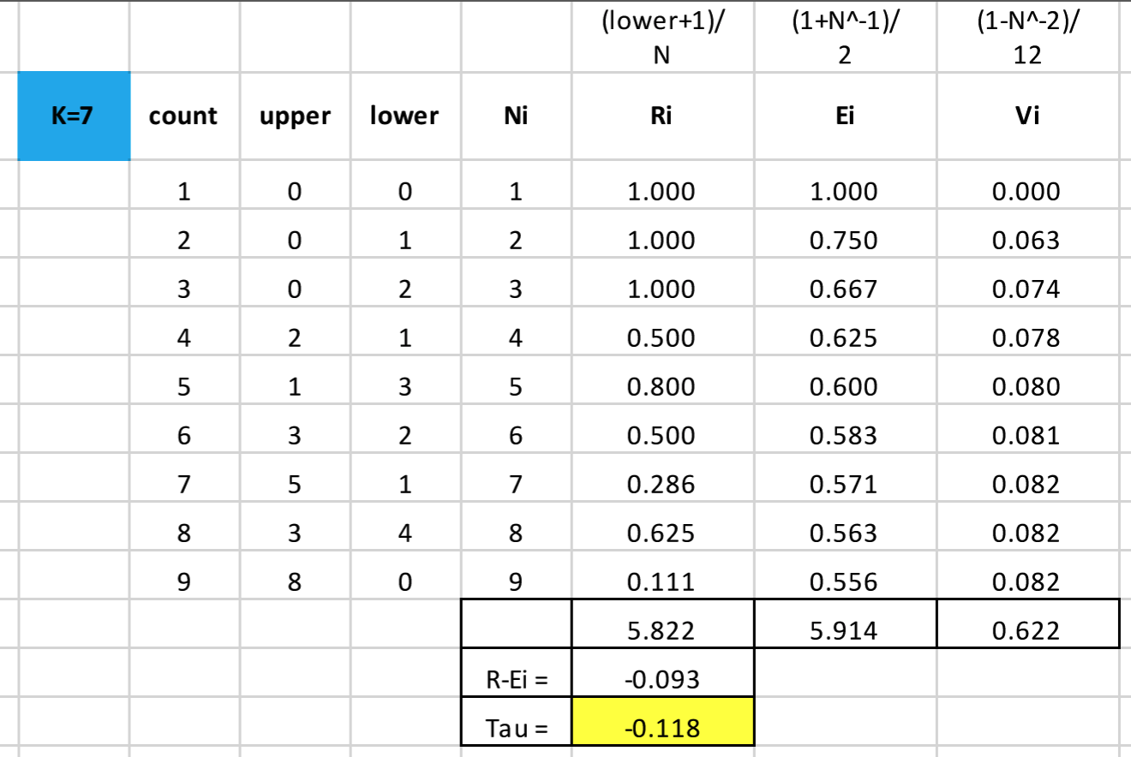
Example calculation: k=7
I calculate kendall tau for k=7.

Slide 7
Analysis
Based on the calculations on the test data points, kendall tau is 0 when the number of “upper” points is equal to the number of “lower” points.
However, even at high values of k=5 and k=6, the number of “lower” points outnumbers the number of “upper” points, so tau is still positive.
My program currently does the same thing as the Excel calculations I have listed, so it’s possible that my understanding of how kendall tau is calculated is wrong.

